Slide 1
A Data science Project on
“Malignant Comments Classifier”
Submitted by: Santosh Arvind Dharam

Slide 2
Problem Statement
The problem we sought to solve was the tagging of internet comments that are aggressive towards other users. This means that insults to third parties such as celebrities will be tagged as un offensive, but “u are an idiot” is clearly offensive.
Our goal is to build a prototype of online hate and abuse comment classifier which can used to classify hate and offensive comments so that it can be controlled and restricted from spreading hatred and cyber bullying.
.

Slide 3
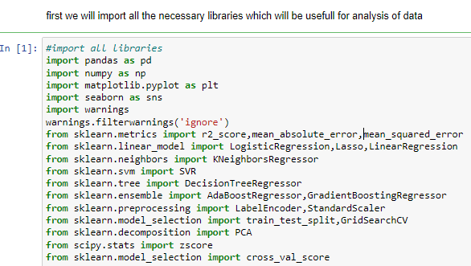
EDA steps step-1(import necessary libraries)

Slide 4
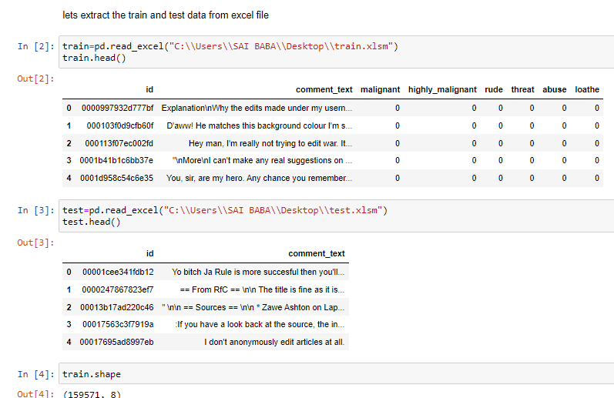
Step-2(extract the dataset in jupyter notebook) Data is extracted for further analysis in jupyter notebook

Slide 5
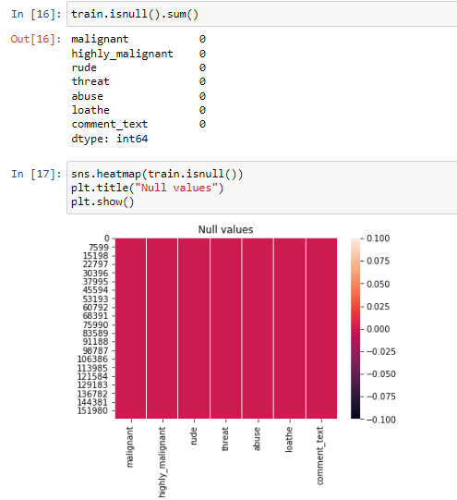
Step-3(checking null values)

Slide 6
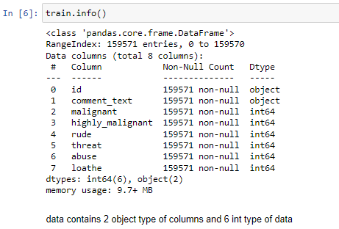
Data information
data contains 2 object type of columns and 6 integer type of dataset some categorical columns and some numerical data

Slide 7
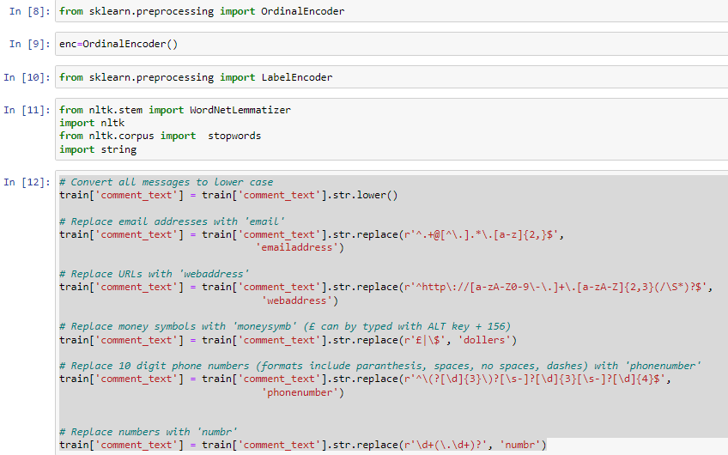
Encoding the Dataset

Slide 8
As the dataset contains some object type of columns and it is need to convert it for further analysis .so we have converted it from object to float or integer. some replacement in dataset is also required, we have did it .column comment text consist of object type of data it is converted to continuous data.

Slide 9
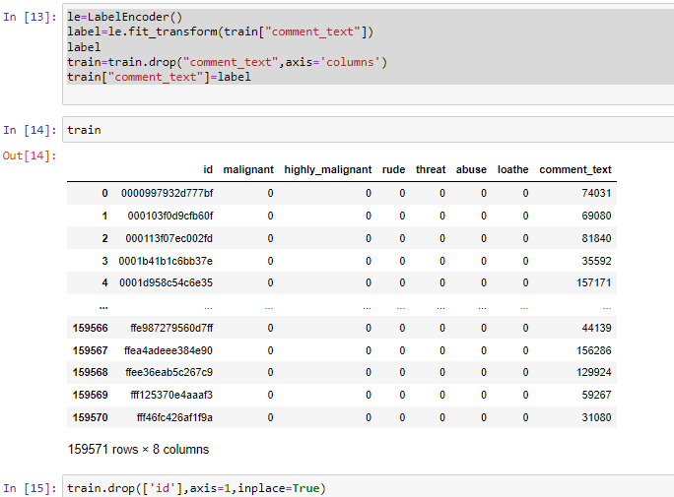

Slide 10
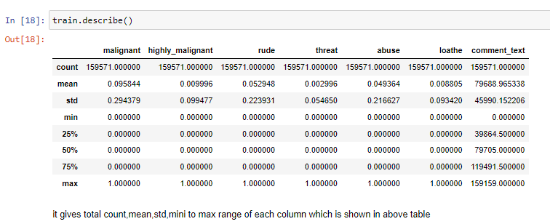
Data Description

Slide 11
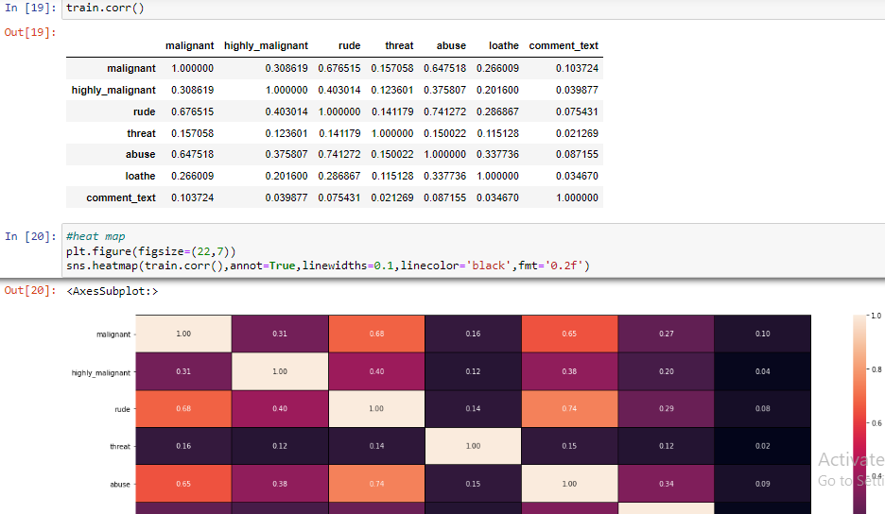
Data Correlation

Slide 12
It shows that some data is having positive correlation and some data is having negative correlation .also it shows that % contribution of data.

Slide 13
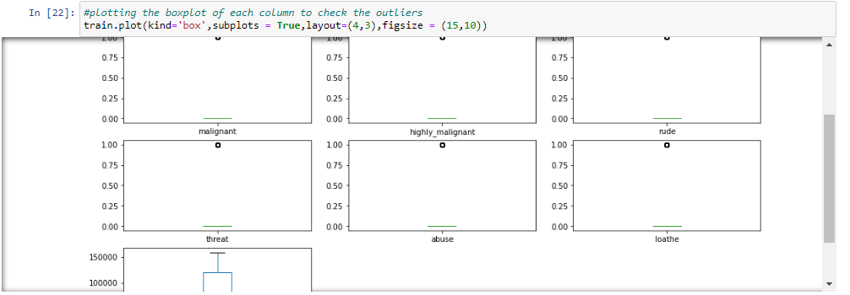
Visualization(Box Plot)

Slide 14
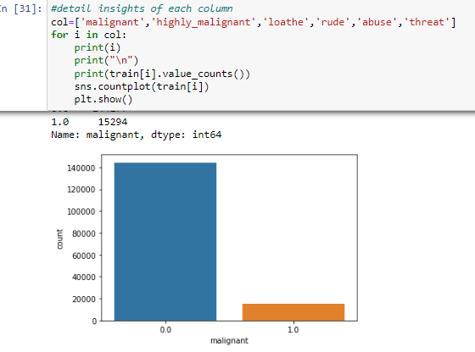

Slide 16
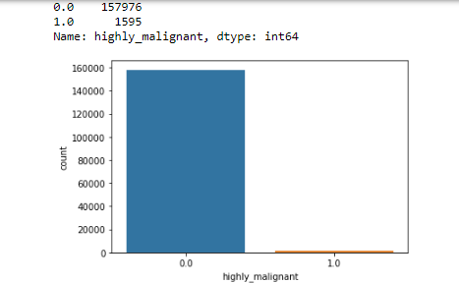

Slide 17
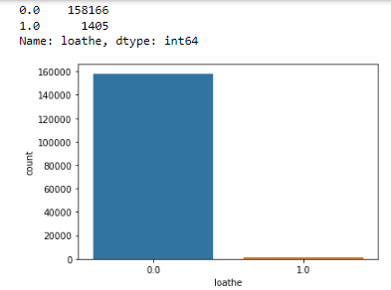

Slide 18
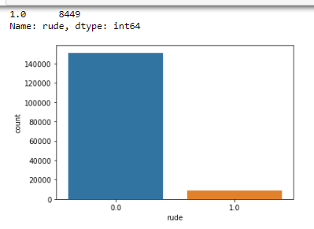

Slide 19
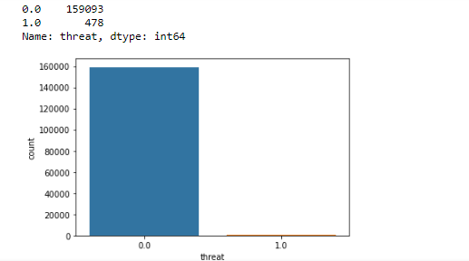

Slide 20
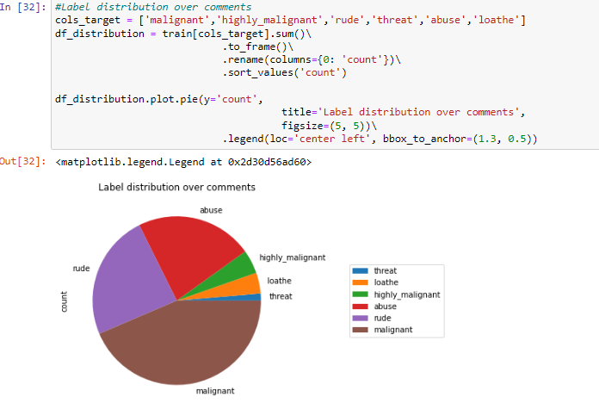
Distribution Plot

Slide 21
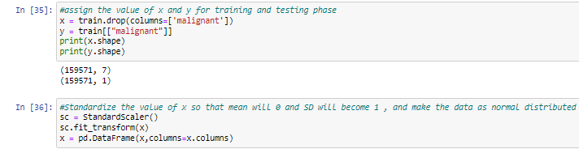
distribution of data into x and y

Slide 22
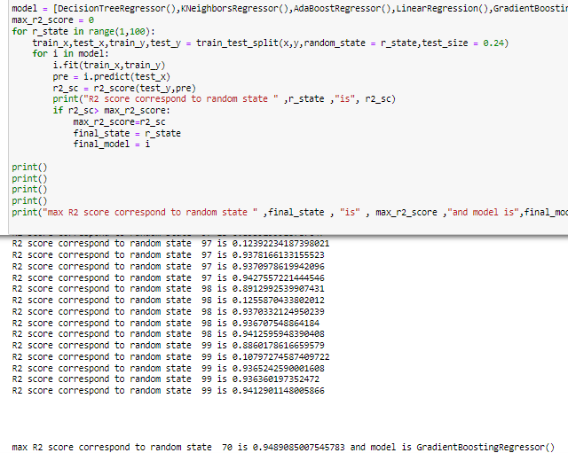
use of multiple algorithm

Slide 23
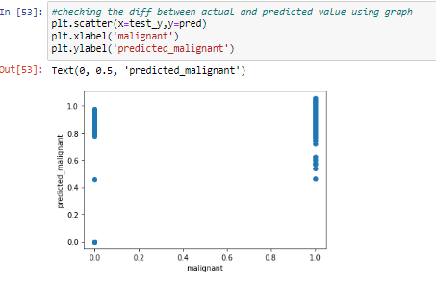
Scatter plot

Slide 24
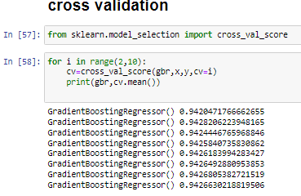
Cross validation

Slide 25
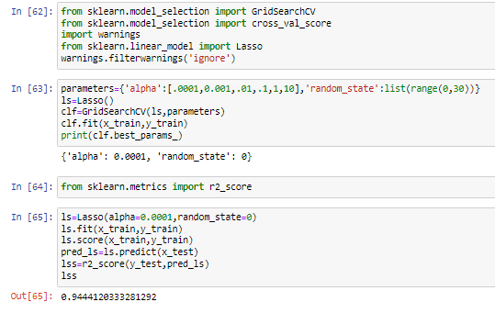
Hyperparameter Tunning

Slide 26
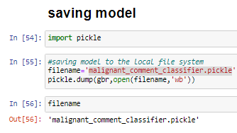
Saving Model
Successfully we have saved model by pickle. Dump

Slide 27

conclusion
We observed that data is cleaned now also some encoding is done now data is uniformly distributed in column. it is also observed from histogram, we have saved model and also predicted the result with help of saved model , model is ready for the future data prediction

